Slide 1
Handling Bigger Data
Data Science for Beginners, Session 10
Notes:
Welcome to the last session in the series. So far, we’ve been learning data science ideas using relatively small datasets. Sometimes you’ll find yourself handling data that’s much larger than your PC can store, or streaming in faster than it can process. Here are some of the things you can do about that.

Slide 2
Session 9 (learning relationships) recap
Relationships and Networks
Network tools
Representing networks
Analysing networks
Visualising networks
Notes:
In the last session, we covered the last of the special datatypes (in these sessions: there are other datatypes, like images and time-series data that we didn’t cover here): relationship data.

Slide 3
Session Topics
People
Designing a data science project
Communicating results
Tools
Python basics
Getting Data
Acquiring data
Cleaning and exploring data
Special data types
Handling text data
Handling geospatial data
Handling big data
Learning from data
Machine learning
Learning relationships from data
Notes:
Here’s where we’ve been in these 10 sessions.
The labs are designed to cover most of what you need to talk to data scientists, to specify your project, and to start exploring data science on your own. They’re specifically aimed at the types of issues that you’ll see in the messy strange world of development, humanitarian and social data.
There’s a lot more to learn from other courses and exploring by yourself: we didn’t cover probability theory or other theories about people’s belief mechanisms, or other specialist datatypes like images, videos, and time-series data.

Slide 4
Session 10: Your 5-7 Things
Bigger, faster data
Big Data Processing
Big Data Storage
Big Data Teams
Notes:
Here’s what we’re covering in this session; essentially, what to do when your data is too big or arriving too quickly for you to handle it on your PC.

Slide 5
The Three (or 4) Vs
Notes:
Let’s talk about the three Vs: Volume, velocity and variety. Which is sometimes called the 4 Vs (“veracity”, or truthfulness is added), and occasionally the 6 Vs (don’t ask, but it’s more about truth).

Slide 6






Volume, Velocity, Variety, Veracity
Notes:
Let’s talk about what’s known as ”the three Vs”. Most development data work is on small data: data that fits comfortably on your PC. Occasionally, you’ll be handling big data. Streaming big data sources include social media, sensor networks, transport data, search engine data, infrastructure data, payment data, internet sites.
[Images: social media logos]

Slide 7
Volume
Name | Size in bytes | Contains (roughly)
Byte | 1 | 1 character (‘a’, ‘1’ etc)
Kilobyte | 1,000 | Half a printed page
Megabyte | 1,000,000 | 1 novella. 5Mb = complete works of Shakespeare
Gigabyte | 1,000,000,000 | 1 high-fidelity symphony recording; 10m of shelved books
Terabyte | 1,000,000,000,000 | All the x-ray films in a large hospital; 10 = library of congress collection. 2.6 = Panama Papers leak
Petabyte | 1,000,000,000,000,000 | 2 = all US academic libraries; 10= 1 hour’s output from SKA telescope
Exabyte | 1,000,000,000,000,000,000 | 5 = all words ever spoken by humans
Zettabyte | 1,000,000,000,000,000,000,000
Yottabyte | 1,000,000,000,000,000,000,000,000 | Current storage capacity of the Internet
Notes:
We need to talk about what ‘big’ means. Here’s what you can fit into one of each of the ****bytes.
“According to the CSIRO, in the next decade, astronomers expect to be processing 10 petabytes of data every hour from the Square Kilometre Array (SKA) telescope.[11] The array is thus expected to generate approximately one exabyte every four days of operation“ Quote and numbers from http://highscalability.com/blog/2012/9/11/how-big-is-a-petabyte-exabyte-zettabyte-or-a-yottabyte.html
Internet storage estimate is from http://www.livescience.com/54094-how-big-is-the-internet.html

Slide 8
Velocity
Twitter firehose:
Firehose averages 6,000 tweets per second
Record is 143,199 tweets in one second (Aug 3rd 2013, Japan)
Twitter public streams = 1% of Firehose steam
Google index (2013):
30 trillion unique pages on the internet
Google index = 100 petabytes (100 million gigabytes)
100 billion web searches a month
Search returned in about ⅛ second
Notes:
Twitter speeds are from https://pushshift.io/tag/twitter/; tweets per second record is from https://blog.twitter.com/2013/new-tweets-per-second-record-and-how (basically, Japan went crazy for a Miyazaki animation, which I thoroughly approve of!)
Google search sizes are from http://venturebeat.com/2013/03/01/how-google-searches-30-trillion-web-pages-100-billion-times-a-month/

Slide 9
Bigger Data
Notes:
Sooner or later, you’ll try to read in a file that’s too big for your computer, or takes forever to process. Here’s some things to do.

Slide 10
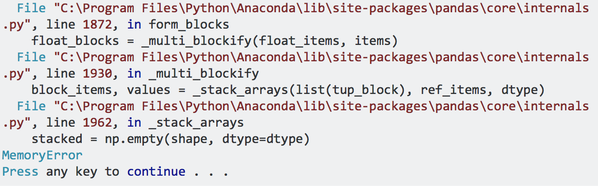
First, Don’t Panic
Notes:
At some point, you’ll probably see an error message like this. If you have a 32-bit machine, this will happen to you a lot. This is because Python on 32-bit machines only uses 2Gb of RAM. http://stackoverflow.com/questions/17557074/memory-error-when-using-pandas-read-csv

Slide 11
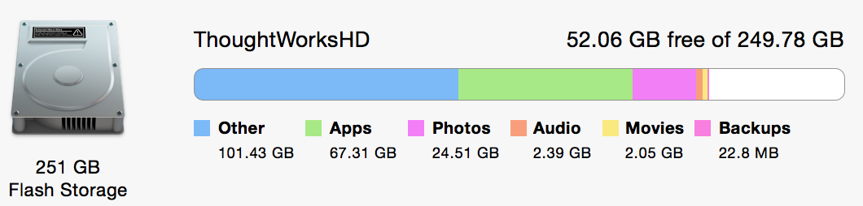
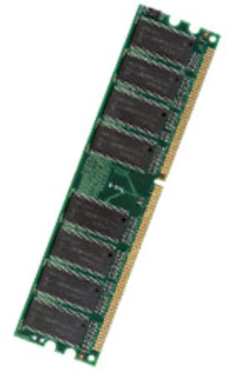
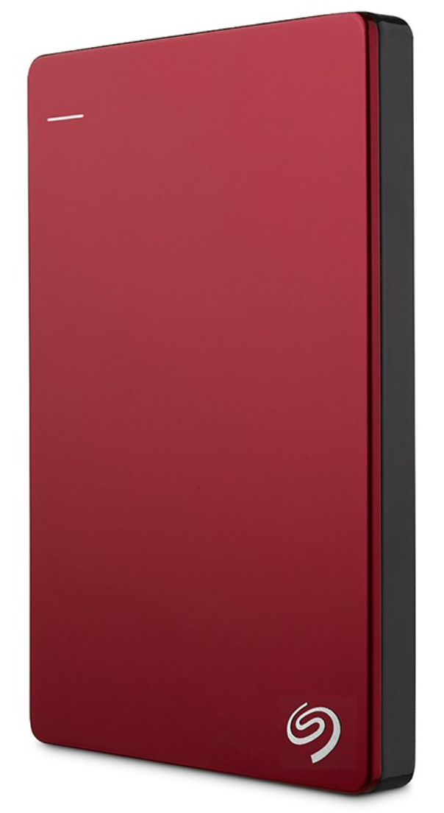
PC data storage
250Gb Internal hard drive. (hopefully) permanent storage. The place you’re storing photos, data etc
16Gb RAM. Temporary storage. The place read_csv loads your dataset into.
2Tb External hard drive. A handy place to keep bigger datafiles.
Notes:
Here’s the storage on a typical laptop. This is where you’re storing your datafiles. Note that a) I don’t have a lot of space left on my 250 Gb hard drive to load files into, b) you can access an external hard drive from Python which means you can keep a stack of these with different datasets on (but think hard about doing this if you’re handling personal or sensitive data), and c) you need to be aware of how much RAM you have because that’s what’s going to max out first (and give you the error we just looked at).
There’s also read-only memory (ROM), where your PC stores internal data that it doesn’t want to lose.

Slide 12
Try this if your data’s too big for your code…
Read data in ‘chunks’
csv_chunks = pandas.read_csv(‘myfile.csv’, chunksize = 10000)
Divide and conquer in your code:
csv_chunks = pandas.read_csv(‘myfile.csv’, skiprows=10000, chunksize = 10000)
Sample from your data
Use a bigger system…
Notes:
So. If you’re getting a memory error when you try to read in a dataset, there are things that you can do. One of them is to read the data in pieces, and process it down to just the datapoints (or summaries) that you need. Another is to use Dask, the parallel processing library that’s built into Anaconda.

Slide 13
Try this if your code’s too slow…
Use %timeit (in a Jupyter notebook) to find where the speed problems are
Use compiled python, (e.g. the Numba library)
Use C code (via Cython)
Use parallel processing (e.g. the Dask library)
Notes:
Numba: http://numba.pydata.org

Slide 14
Big Data Processing
Notes:
At some point, even if you’re trying hard to use Dask, reading in chunks etc, your PC just won’t be able to handle the volume or speed that data is coming at your code. At that point, we’re into big data territory.

Slide 15
Distributed Systems
Store the data on multiple ‘servers’:
Replicate data (because server hardware breaks more often than you think)
Big idea: Distributed file systems
Do the processing on multiple servers:
Lots of code does the same thing to different pieces of data
Big idea: Map/Reduce
Notes:
So how do we deal with all this volume and velocity? This was Google’s problem in the 00s. They designed and built a distributed filesystem and processing method.

Slide 16
Distributed Systems
Smartphone: 8 cores, 3 GB RAM, 32 GB memory, up to 256 GB on a microSD card
Laptop: 4 cores, 16 GB RAM, 256 GB disk
Workstation: 24 cores, 1 TB RAM
Clusters (e.g. cloud computing): as big as you can imagine…
Notes:
You probably already have several processors on your PC (and phone): that’s what the “quad-core” part of its specification means. Here are some typical numbers for number of processors (‘cores’) and memory sizes.

Slide 17
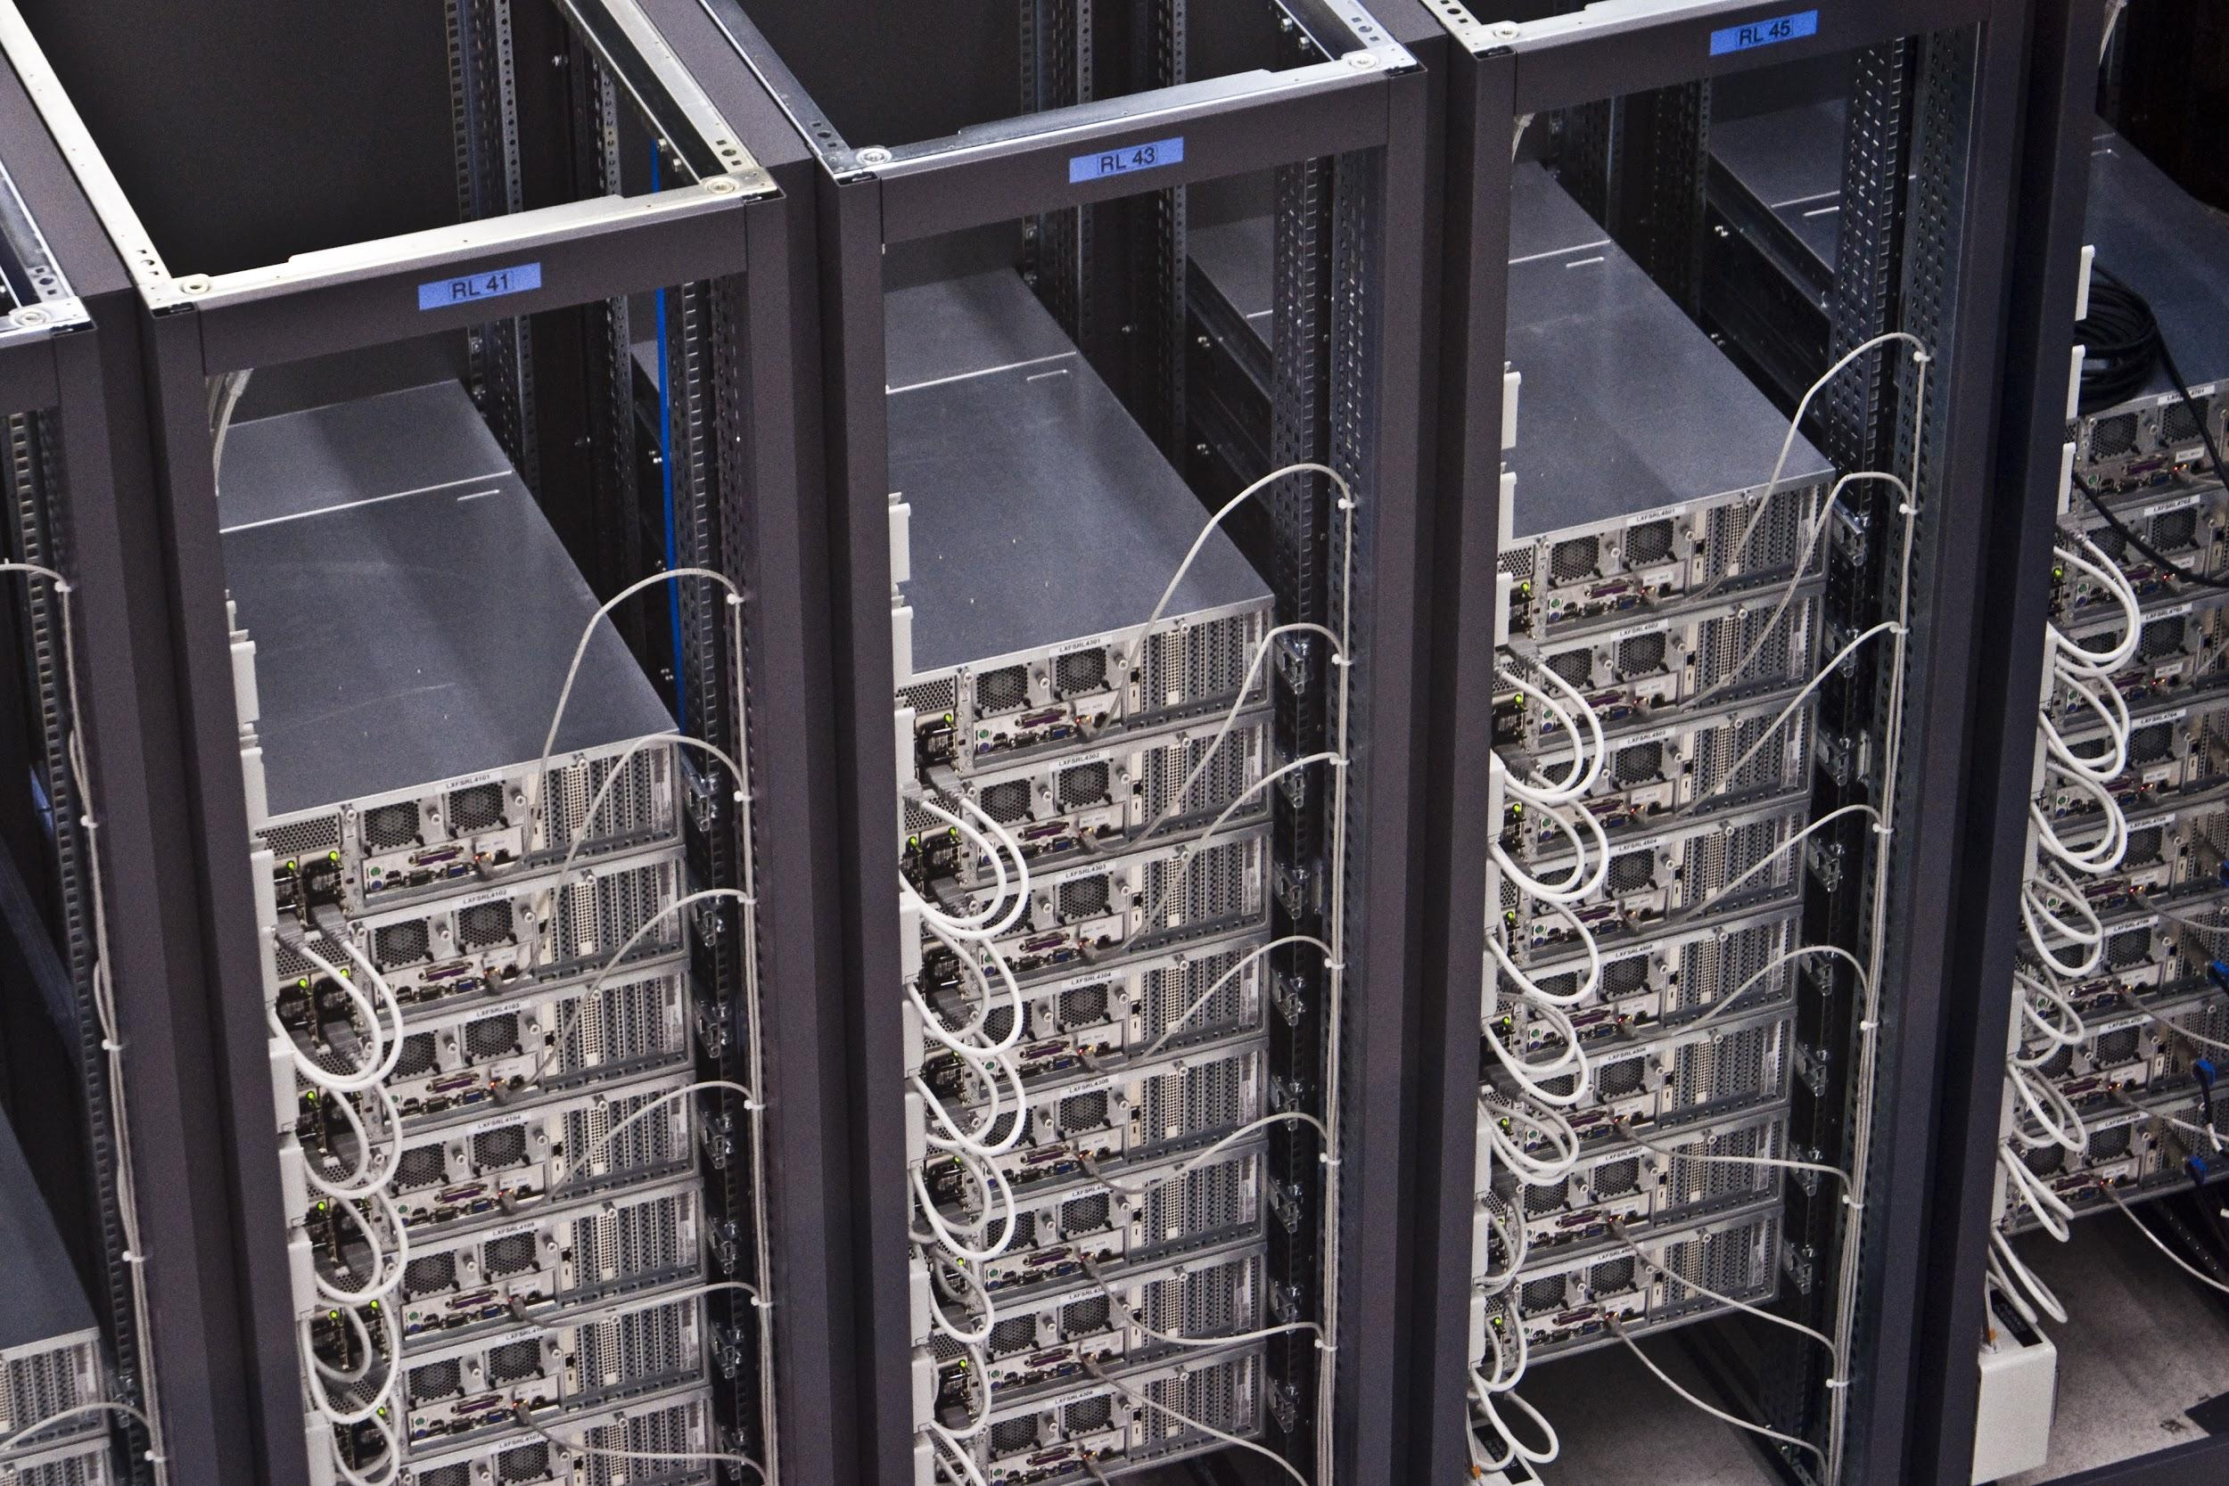
Clusters and Cloud Computing
Notes:
Online data services (e.g. Amazon Web Services) are an easy way to access large numbers of processors at relatively low cost (or free if you’re careful).
If you use an online service like AWS to store and process your big datasets, this is the sort of place where it will physically sit: a ‘rack’ of ’servers’ (computers without monitors etc) in a data centre. If you’re curious about where these are, here are all the Google data centre locations: https://www.google.com/about/datacenters/inside/locations/index.html. And you should be curious about data centre locations, because the laws applied to a data centre in the USA (e.g. whether USA security services can ask to view all your datasets) are different to the laws applied in other countries. If this is a concern for you, look for advice from places like the Tactical Technology Collective.
[Image: rack servers]

Slide 18

HDFS Distributed Systems
Notes:
Once you get into cloud computing, you’ll probably run across a HDFS data storage system (aka “HDFS filesystem”). This is HDFS in all its gory detail. The yellow boxes are servers (computers) grouped (usually physically) into racks.
[image: Wikipedia page on HDFS]

Slide 19
Distributed Programming
Hadoop:
MapReduce engine: processing
Apache:
Spark: In-memory processing
Because moving data around is the biggest bottleneck
Notes:
HDFS is part of the Hadoop system infrastructure. Hadoop is built as a set of modules that can be used together, or as part of other systems. Whilst HDFS is often used to store data, different modules can be used for processing. Here are two of the more common ones: Hadoop’s MapReduce, and Apache’s Spark.
Map/reduce fetches data then processes it. This means moving the data, which can take a lot of time. Spark solves this by doing the processing in the same place as the data: this is why it’s much faster than Hadoop Map/Reduce.
Panama Papers = 252 days to download on a fast server… http://www.livescience.com/54348-how-big-is-panama-papers-leak.html
Python and Spark? Use PySpark (see http://blog.cloudera.com/blog/2016/02/making-python-on-apache-hadoop-easier-with-anaconda-and-cdh/ for how to do this in notebooks)

Slide 20
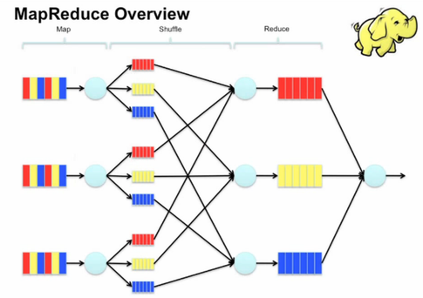
MapReduce
Notes:
Map/Reduce is like crowdsourcing for computers.
https://www-01.ibm.com/software/data/infosphere/hadoop/mapreduce/
https://vimeo.com/13554436
https://www.quora.com/What-is-an-intuitive-explanation-of-MapReduce
Good example code for this: http://www.michael-noll.com/tutorials/writing-an-hadoop-mapreduce-program-in-python/
[Image: ]

Slide 21
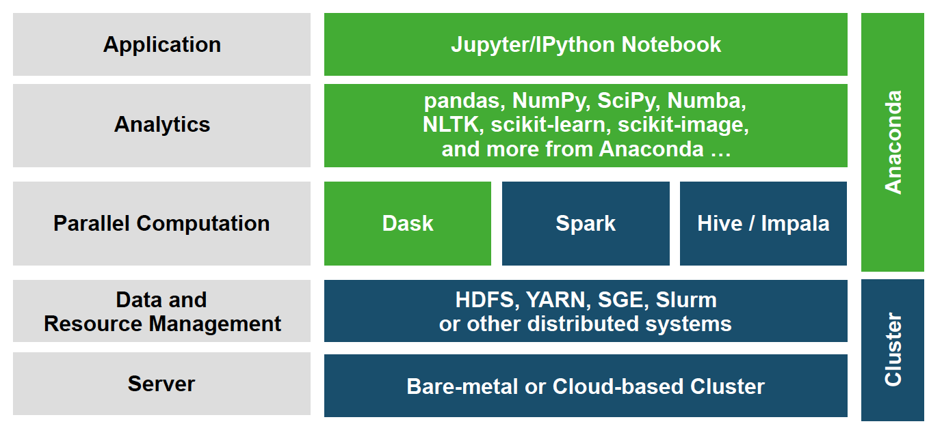
Anaconda comes with this…
Notes:
Anaconda includes a bunch of tools for handling bigger data.

Slide 22
Python parallel-processing libraries
Dask
Direct access into HDFS, S3 etc
Datasets look like Numpy Arrays or Pandas DataFrames
Commands look similar, e.g.
df.groupby(df.index).value.mean()
PySpark
Connects to Spark
Also has DataFrames
Notes:
Pyspark: http://www.slideshare.net/hkarau/a-really-really-fast-introduction-to-py-spark-lightning-fast-cluster-computing-with-python-1

Slide 23
Typical Current Ecosystem
Data warehouse
Publisher
Python
Spark
SQL
R
Tableau
HDFS

Slide 24
Data Storage
Notes:
So far, we’ve been storing datasets on our PCs, loading them into things like Pandas dataframes and processing them on our PCs too. When data gets big, that’s not always an option. Here are some of the ways that big data gets stored.

Slide 25
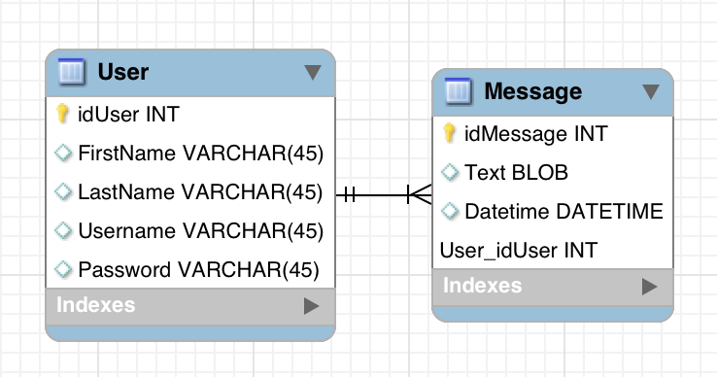
SQL Databases
Row/column tables
Keys
SQL query language
Joins etc (Pandas joins are based on these)
Notes:
Most relational databases are based on the SQL query language. Many big data technologies (e.g. HIVE) still have SQL-like commands to access data in them. In short, it’s a good idea for you to learn the SQL query language.
A SQL database is basically row/column tables, connected by ‘keys’ that identify specific table rows (e.g. user id). A good place to play with SQL queries is the sqlite3 python library. SQLite is a lightweight version of a database language: it stores each database in a file, which means you don’t need to set up any infrastructure to use it. A good place to practice SQL design is MySqlWorkbench.
[Image: simple database design, in MySQLWorkbench]

Slide 26
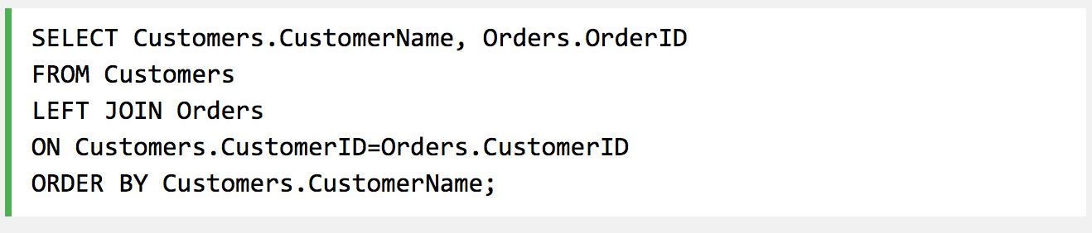
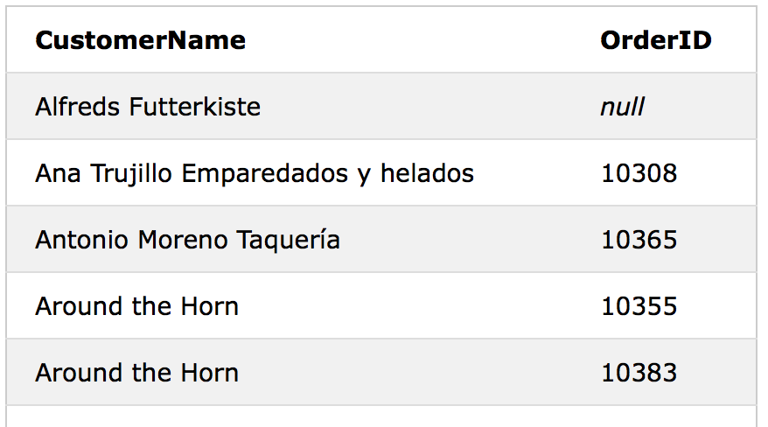
Learning the SQL language is helpful…
Notes:
[Images: examples from W3Schools SQL tutorial http://www.w3schools.com/sql/sql_join_left.asp]

Slide 27
ETL Systems (Extract-Transform-Load)
Extract
Extract data from multiple sources
Transform
Convert data into database formats (e.g. sql)
Load
Load data into database
Notes:
ETL systems (e.g. Pentaho’s Kettle system) are still popular for processing row-column data.

Slide 28
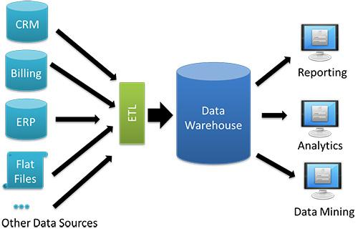
Data Warehouses
Notes:
[Image: TBR]

Slide 29
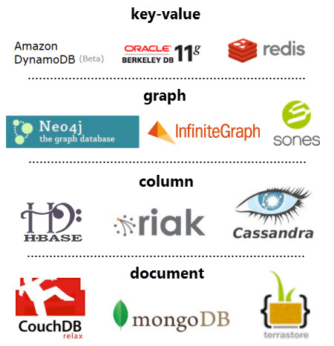
NoSQL Datastores
Data isn’t forced into row/column form
Lots of different types of these, e.g.
Key/value: can add feature without rewriting tables
Graph: stores nodes and edges
Column: useful if you have a lot more reads than writes
Document (e.g. MongoDb): general-purpose.
Notes:
You’ll probably see MongoDb a lot. More: http://www.tomsitpro.com/articles/rdbms-sql-cassandra-dba-developer,2-547-2.html
[Image: ]

Slide 30
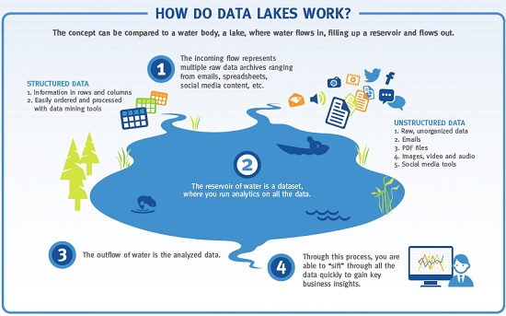
Data Lakes
Notes:
Big thing about data lakes is that you don’t do the transformation when you put data into them… you do this when you take data out.
[Image: TBR]

Slide 31
Data Teams
Notes:
When you go beyond doing data science experiments, and get into big data and building production-level data systems, you’ll probably find yourself part of a data team. Here are some of the characters you’re likely to work with.

Slide 32
Data Teams
Usually see:
Project manager
Business analysts: understanding the system
Data scientists and data analysts
Data engineers and developers
Sometimes see:
Data architect
User experience developer, user interface developer, visual designer
Algorithm specialists (e.g. machine learning, image processing etc)
Notes:
What they’re all doing:
Business analysts: understanding the system
Data scientists, data analysts: insight from data, prototype algorithms
Data engineers and developers: implementing data architectures (including data flows), productionising algorithms
Data architect:
Ux/UI/visual designers: system design
Many of these roles overlap. For instance, at the start of a project, BS and DSs are both trying to understand business systems and what’s important in them. DSs and Des both care about how data is stored and accessed, and about the implications of choosing different languages or algorithm applications.

Slide 33
Data Team Work
Data analysis
Data science
Data engineering
Data strategy
Notes:
Data teams, especially consulting data teams, do a lot more than just data science. Here are some of those things.

Slide 34
Data Analysis
What are the statistics of this dataset?
E.g. which pages are popular
Usually on already-formatted data, e.g. google analytics results
Notes:
The differences between data analysis and data science have been written about a lot.

Slide 35
Data Science
Ask an interesting question
Get the data
Explore the data
Model the data
Communicate and visualize your results
Notes:
We know this one. We’ve been doing it. Except when the data gets big or fast, you start to need to include a data engineer…

Slide 36
Data Engineering
Big data storage
SQL, NoSQL
warehouses, lakes
Cloud computing architectures
Privacy / security
Uptime
Maintenance
Big data processing
Distributed programming platforms
Privacy / security
Uptime
Maintenance
etc.
Notes:
Data engineers keep the lights on.

Slide 37
Data Strategy
Needs:
Which business questions does this place have?
Why should data be important here?
Resources:
What data does/could this place have access to?
How much data work is already here?
Who has the data science gene?
What needs to change to make this place data-driven?
People (training, culture)
Processes
Technologies (data access, storage, analysis tools)
Data

Slide 38
Exercises

Slide 39
Exercises
More in notebook 10.1
Use pandas read_csv() to read a datafile in in chunks
Try the Hadoop tutorial http://hortonworks.com/hadoop-tutorial/hello-world-an-introduction-to-hadoop-hcatalog-hive-and-pig/
NB You’ll need to install a virtual machine like VirtualBox, Vmware or Docker for this
Notes:
And read http://www.slideshare.net/continuumio/high-performance-hadoop-with-python-webinar

